Slide 1
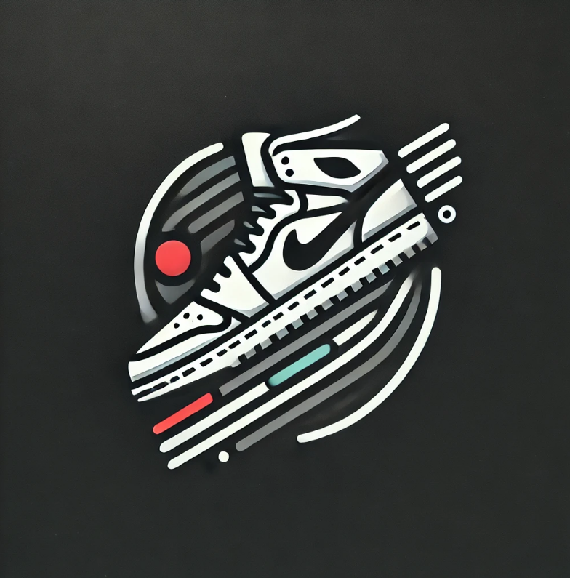

SneakR
Team members:
Tóth Krisztián
Kenéz Bence
Kreszl Tamás
Notes:
(Presenter: Kreszl Tamás)
Good afternoon everyone, and welcome to our presentation! Today, we’re excited to introduce you to SneakR, an innovative platform designed to transform the sneaker marketplace.
Let's start by introducing our team. We are Tóth Krisztián, Kenéz Bence, and Kreszl Tamás.
Over the next few minutes, we’ll walk you through the problems we identified in the sneaker market, how SneakR solves these challenges, the design and technical architecture behind it, and our plans for the future. Let's dive in!

Slide 2
The Problem
Limited Options
Existing sneaker stores often lack variety and offer a limited selection of brands and styles. This makes it difficult for sneaker lovers to find the perfect shoes.
High fees
Many online marketplaces charge significant fees for both buyers and sellers, especially when dealing with used sneakers. This increases the overall cost for buyers and reduces the profit for sellers, which makes the process less attractive.
Few platforms
There are few platforms that are easy for resellers to use and where used shoes can be sold easily.
Notes:
(Presenter: Kreszl Tamás)
Now, let’s talk about why SneakR exists. The current sneaker market is facing some major issues:
These pain points led us to develop SneakR – a solution that offers a better, more efficient way to buy, sell, and discover sneakers. Let’s now look at how we are tackling these challenges.

Slide 3
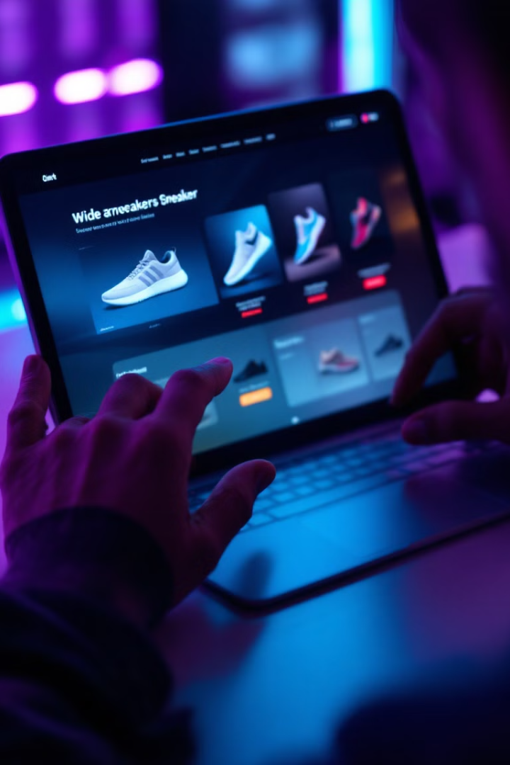
SneakR’s solution
1
Comprehensive Selection
2
Low fees
Our platform offers a wide range of popular brands, ensuring customers find their perfect match.
While many platforms charge hefty transaction fees, SneakR generates revenue primarily through advertisements, allowing us to drastically reduce fees.
3
Our platform
We are the only platform where you can buy and sell shoes either from a another reseller, or from our website.
Notes:
(Presenter: Tóth Krisztián)
SneakR addresses these issues with three key features:
Comprehensive Selection: We offer a vast selection of popular sneaker brands. This ensures that customers can find exactly what they’re looking for, whether it’s the latest release or a classic design. SneakR provides a range of styles and sizes to cater to every sneaker enthusiast’s needs.
Low Fees: We aim to keep costs low. While many platforms charge hefty transaction fees, SneakR generates revenue primarily through advertisements, allowing us to drastically reduce fees. This creates a win-win situation for buyers and sellers alike, making transactions more affordable and appealing.
Our Platform: Unlike other platforms, SneakR is the only one where you can buy directly from us or from other resellers in our peer-to-peer marketplace. This dual approach gives users flexibility and more options, allowing them to either find shoes from a trusted reseller or directly from SneakR itself.
This is how we’re solving the problems we discussed earlier. But, what does SneakR look like in practice? Let’s take a look at our Design Plan.

Slide 4
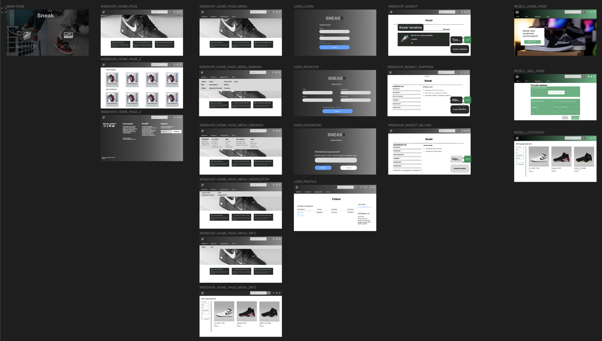
Design plan
Notes:
(Presenter: Kenéz Bence)
Our design focuses on simplicity and usability. The wireframes and mockups you see here represent our vision for the user interface. The aim is to create an intuitive platform where users can easily navigate, search for shoes, check out, and connect with other users.
We've created a clean, modern design with easy-to-use search functionality, clear categorization, and user-friendly shopping experience, whether users are browsing products or reselling sneakers.

Slide 5
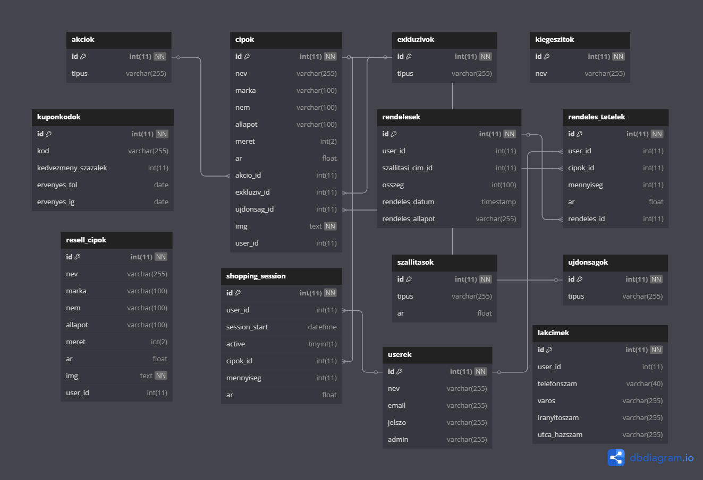
Database plan
Notes:
(Presenter: Kreszl Tamás)
Behind the scenes, we have a robust database designed to handle complex data related to products, users, orders, and payments.
The system ensures that product information, user data, transaction details, and order status are stored efficiently and securely.
This database is scalable and flexible, ensuring that it can grow as our platform grows. It’s an essential part of the platform’s foundation, ensuring smooth operations for every user.

Slide 6
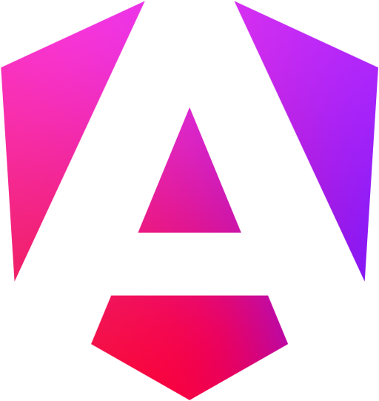


Architectures used in our project
Frontend (Angular, Typescript)
Backend (Java)
Database (MySQL)
The user interface is built with Angular, a popular framework for creating dynamic and responsive web applications.
The server-side logic is implemented using NodeJS, a robust and scalable runtime environment for JavaScript.
We chose MySQL as our database that provides flexibility and scalability for storing data about products, customers, and orders.
Notes:
(Presenter: Tóth Krisztián)
We’ve carefully selected the technology stack to ensure that SneakR is fast, reliable, and scalable. Here’s how we’ve built it:
Frontend: We’re using Angular and TypeScript for the frontend. Angular is a powerful framework that allows us to build dynamic, responsive, and fast web applications, while TypeScript adds type safety and clarity to our code.
Backend: For the server-side logic, we use Java with Node.js, making the platform both scalable and efficient.
Database: The data is securely stored in a MySQL database. MySQL allows us to manage large volumes of data reliably while keeping performance high.
Together, these technologies form a powerful and reliable stack that supports SneakR’s features and user needs.

Slide 7
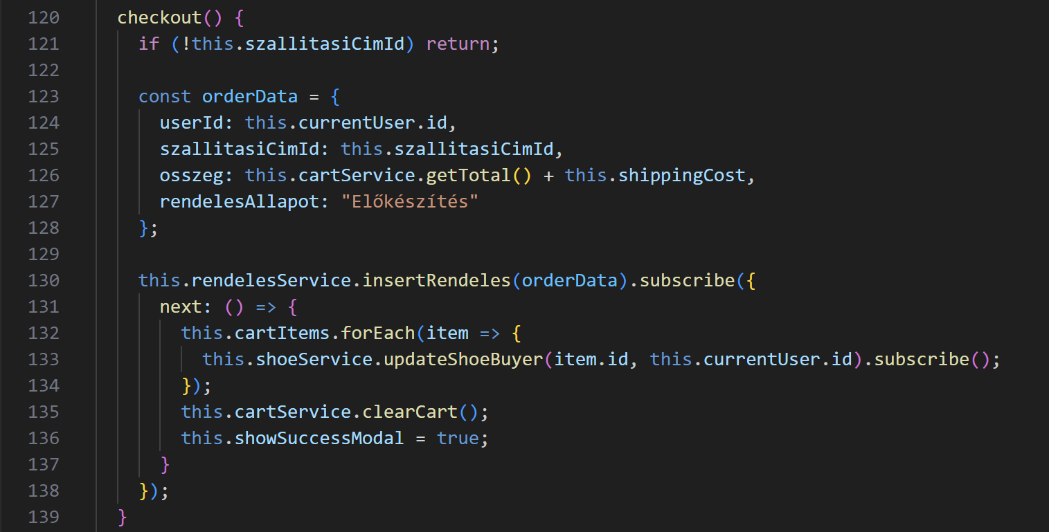
Frontend (Angular, Typescript)
Notes:
(Presenter: Kenéz Bence)
Let’s dive into some of our code. Here, we have an example of the Angular code that powers our checkout process. This piece of code interacts with our backend services to process user orders.
It ensures that users can smoothly move from selecting sneakers to confirming their order, while also managing the cart’s contents and finalizing the transaction.

Slide 8
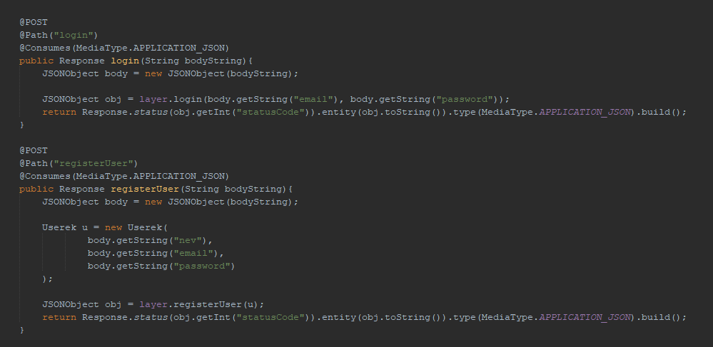
Backend (Java)
API request for login and register
Notes:
(Presenter: Tóth Krisztián)
On the backend, we’ve implemented APIs for user login and registration, ensuring secure user data handling. Here’s an example of the code responsible for processing login and registration requests.
The system ensures data privacy and security, allowing only authenticated users to access their profiles and make transactions.

Slide 9
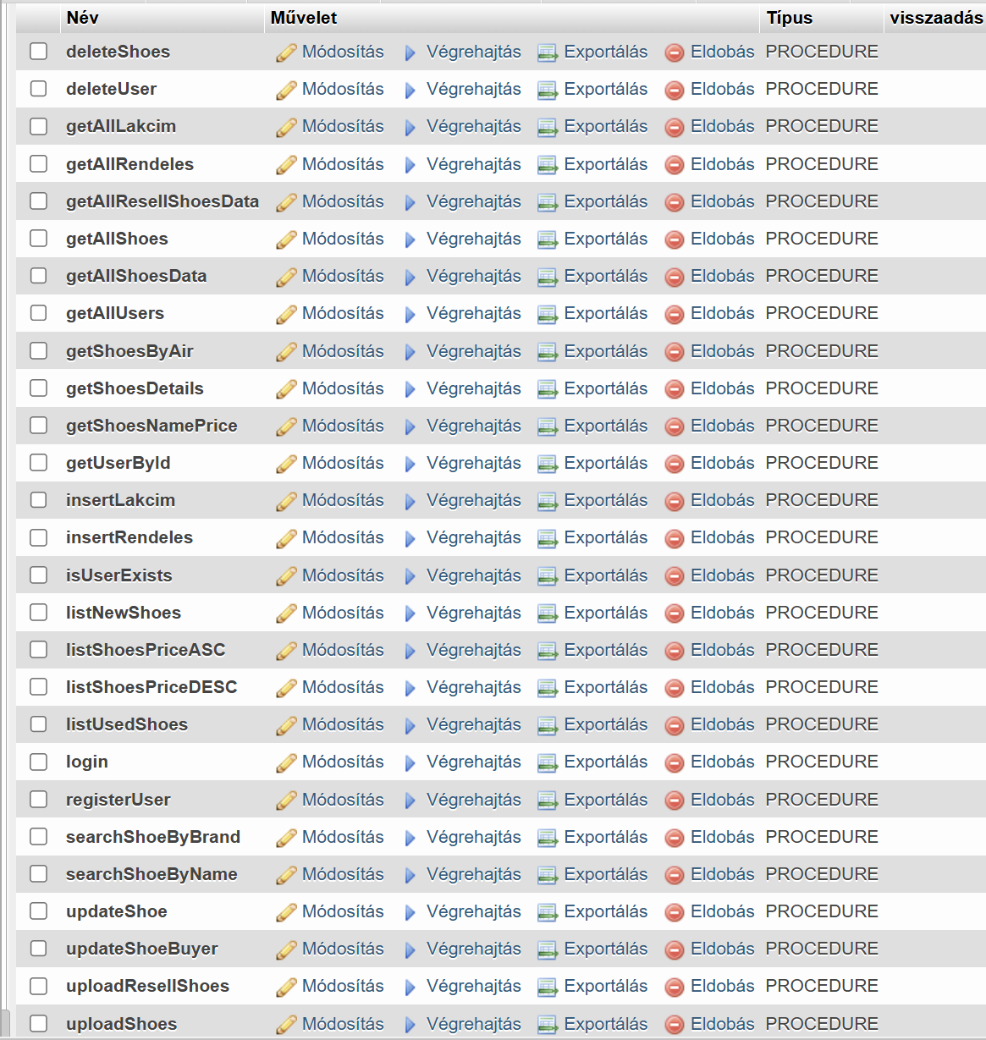
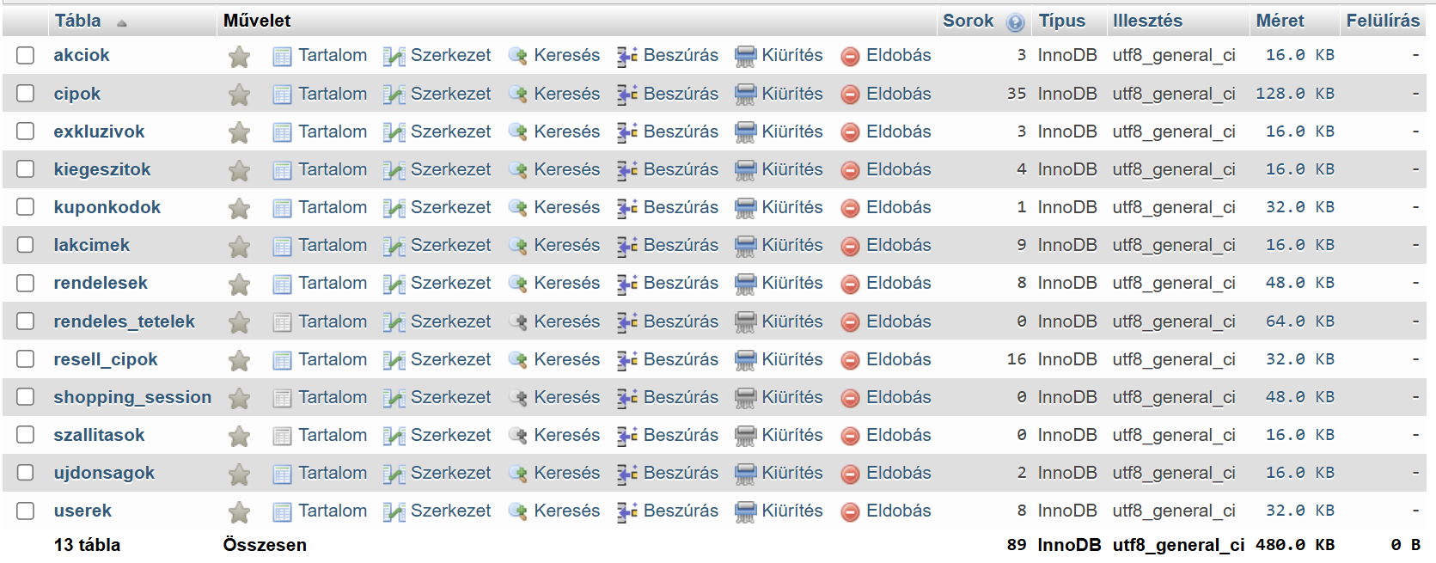
Database (MySQL)
Database Routines
Database Structure
Notes:
(Presenter: Kreszl Tamás)
Next, let’s look at our database routines. These handle tasks such as retrieving product data, managing user sessions, and processing orders.
The database structure is optimized for speed, ensuring that queries are efficient and that the platform can handle a large number of users simultaneously. This is crucial for maintaining smooth operation as our community grows.

Slide 10

Teamwork and Project Management
1
Git
We used Git for version control, allowing us to track changes, collaborate effectively, and manage code branches.
2
Jira
Jira served as our project management tool, enabling us to track tasks, assign roles, and monitor progress.
3
Communication
We established clear communication channels, including regular meetings and online discussions on Discord, to ensure smooth collaboration and effective problem-solving.
Notes:
(Presenter: Kenéz Bence)
OLVASD FEL

Slide 11
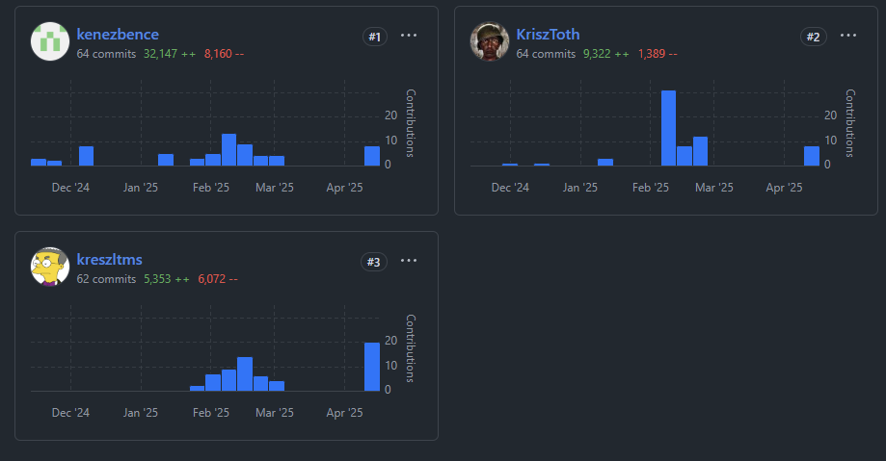
Teamwork and Project Management
Github commit distribution
Notes:
(Presenter: Tóth Krisztián)
Here’s a look at our GitHub commit distribution. As you can see, everyone contributed significantly to the project, with each member making substantial commits.
This reflects our collaborative effort over the course of the development process, ensuring that the codebase is constantly improving and evolving.

Slide 12
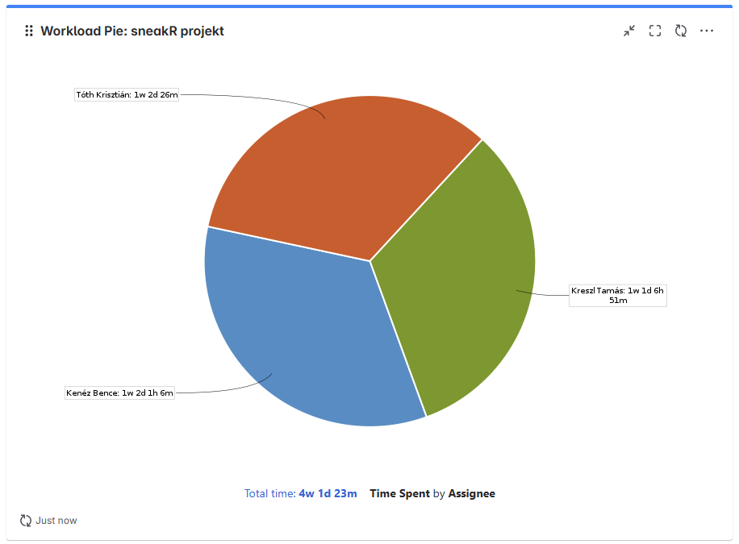
Teamwork and Project Management
Jira Workload
Notes:
(Presenter: Tóth Krisztián) (felolvasós)
Now, let’s look at the Jira workload distribution. This pie chart breaks down how much time each of us spent on the project.
Kenéz Bence worked for 3 days, 7 hours, and 2 minutes; Kreszl Tamás spent 3 days, 3 hours, and 31 minutes; and Tóth Krisztián contributed 4 days, 1 hour, and 8 minutes. This shows how the workload was shared evenly across the team.

Slide 13

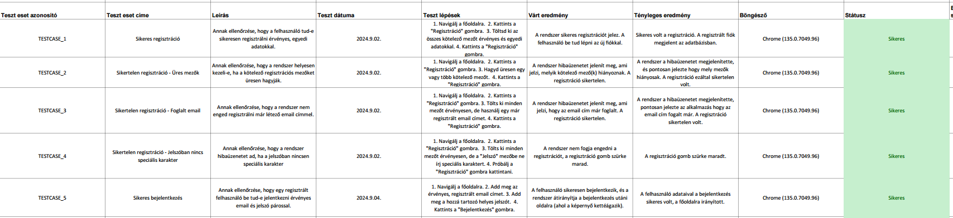
Manual Testing
We conducted manual tests to ensure individual components and the overall application behaved as expected from a user's perspective.
This involved interacting with the application's interface, inputting various data, and verifying outputs against anticipated results.
This Helped confirm usability, functionality, and accuracy of the software before deployment.
Notes:
(Presenter: Kreszl Tamás) (felolvasós)
OLVASD FEL

Slide 14

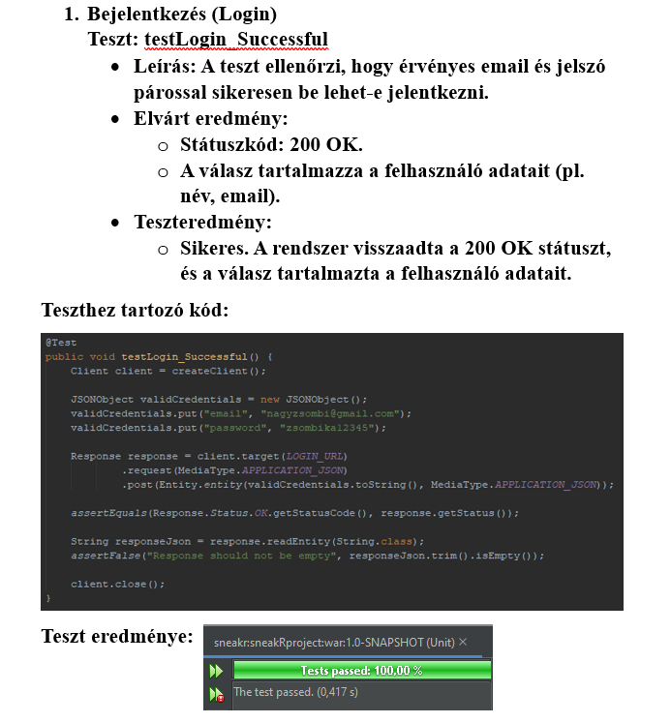
Unit Testing
We Wrote automated tests for the smallest, independently testable parts of the code.
With NetBeans' built-in tool JUnit integration to quickly and efficiently create and run test cases.
This testing Ensures that individual code units function according to specifications.
Notes:
(Presenter: Kreszl Tamás) (felolvasós)
OLVASD FEL

Slide 15
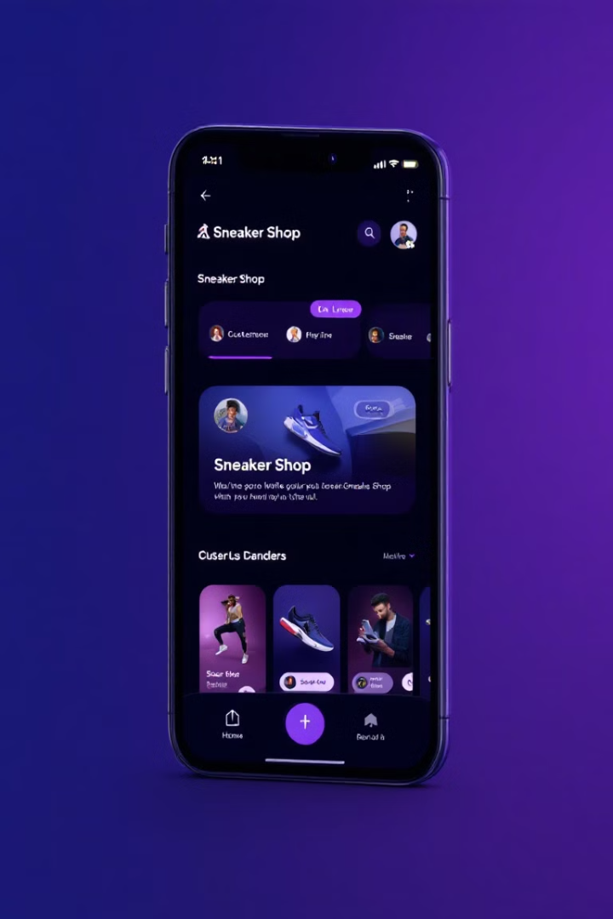
Next Steps
Integrating SimplePay
We plan to integrate SimplePay secure payment system.
Mobile application development
We will start developing the Mobile application.
Feedback
We will continuously gather feedback from users and make adjustments to improve the platform's functionality and user experience.
Notes:
(Presenter: Kenéz Bence) (felolvasós)
Looking ahead, we have several exciting plans for SneakR:
Integrating SimplePay:
Mobile Application:
Continuous Feedback:

Slide 16
Thank you for watching our presentation!
Now let's move on to the live demonstration of our application!
Notes:
(Presenter: Kreszl Tamás) (felolvasós)
Thank you for watching our presentation. We’re excited to show you how SneakR works, so now let’s move on to the live demo!

